Slide 1

Big Data Visual Analytics (CS 661)
Instructor: Soumya Dutta
Department of Computer Science and Engineering
Indian Institute of Technology Kanpur (IITK)
email: soumyad@cse.iitk.ac.in

Slide 2
Study Materials for Lecture 5
William E. Lorensen and Harvey E. Cline. 1987, “Marching cubes: A high resolution 3D surface construction algorithm”. SIGGRAPH Comput. Graph. 21, 4 (July 1987), 163–169. https://doi.org/10.1145/37402.37422.
Reference: “Resolving the Ambiguity in Marching Cubes” by Nielson and Hamman, IEEE VIS’91.
The Visualization Toolkit by Will Schroeder, Ken Martin, Bill Lorensen
Chapter 6

Slide 3
Acknowledgements
Some of the following slides are adapted from the excellent course materials and tutorials made available by:
Prof. Han-Wei Shen (The Ohio State University)
Prof. Klaus Mueller (State University of New York at Stony Brook)
David DeMarle (Intel)

Slide 4
VTK Examples
Show2DData.py
ExtractCell.py
LoadPolyData.py
Polyline.py

Slide 5
Isocontour Algorithm (2D and 3D)

Slide 6
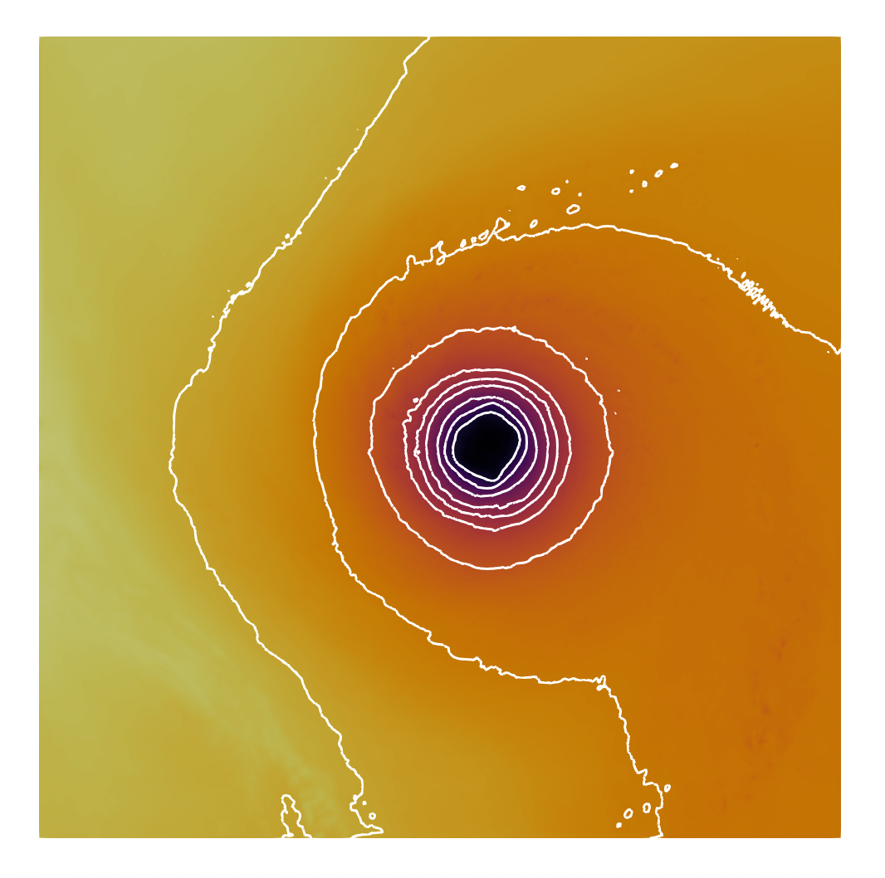
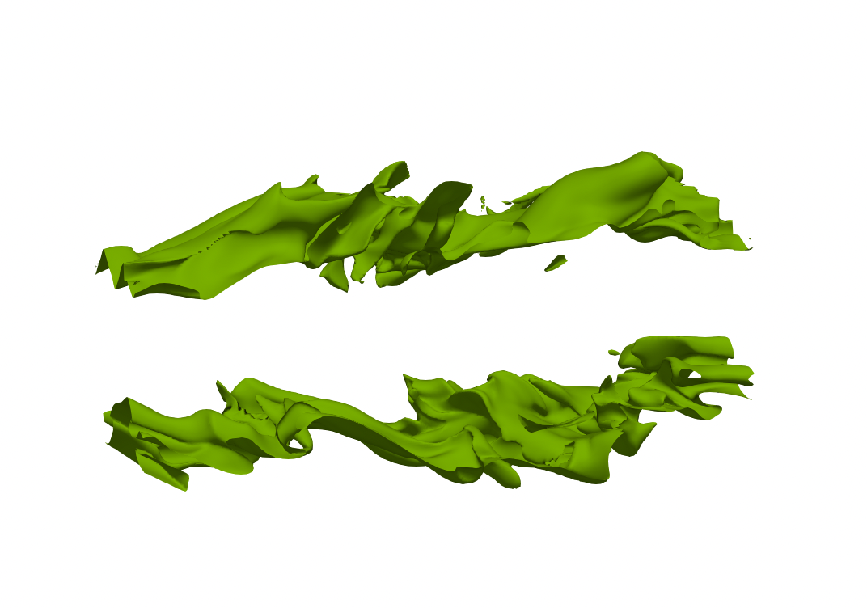
What is an Isocontour?
2D isocontour: Isoline
An Isocontour is a curve(2D)/surface(3D) in a scalar field where the value of the scalar function is constant across the domain
2D: isoline
3D: Isosurface
A technique for analyzing and visualizing scalar field data or scalar functions
3D isocontour: Isosurface

Slide 7
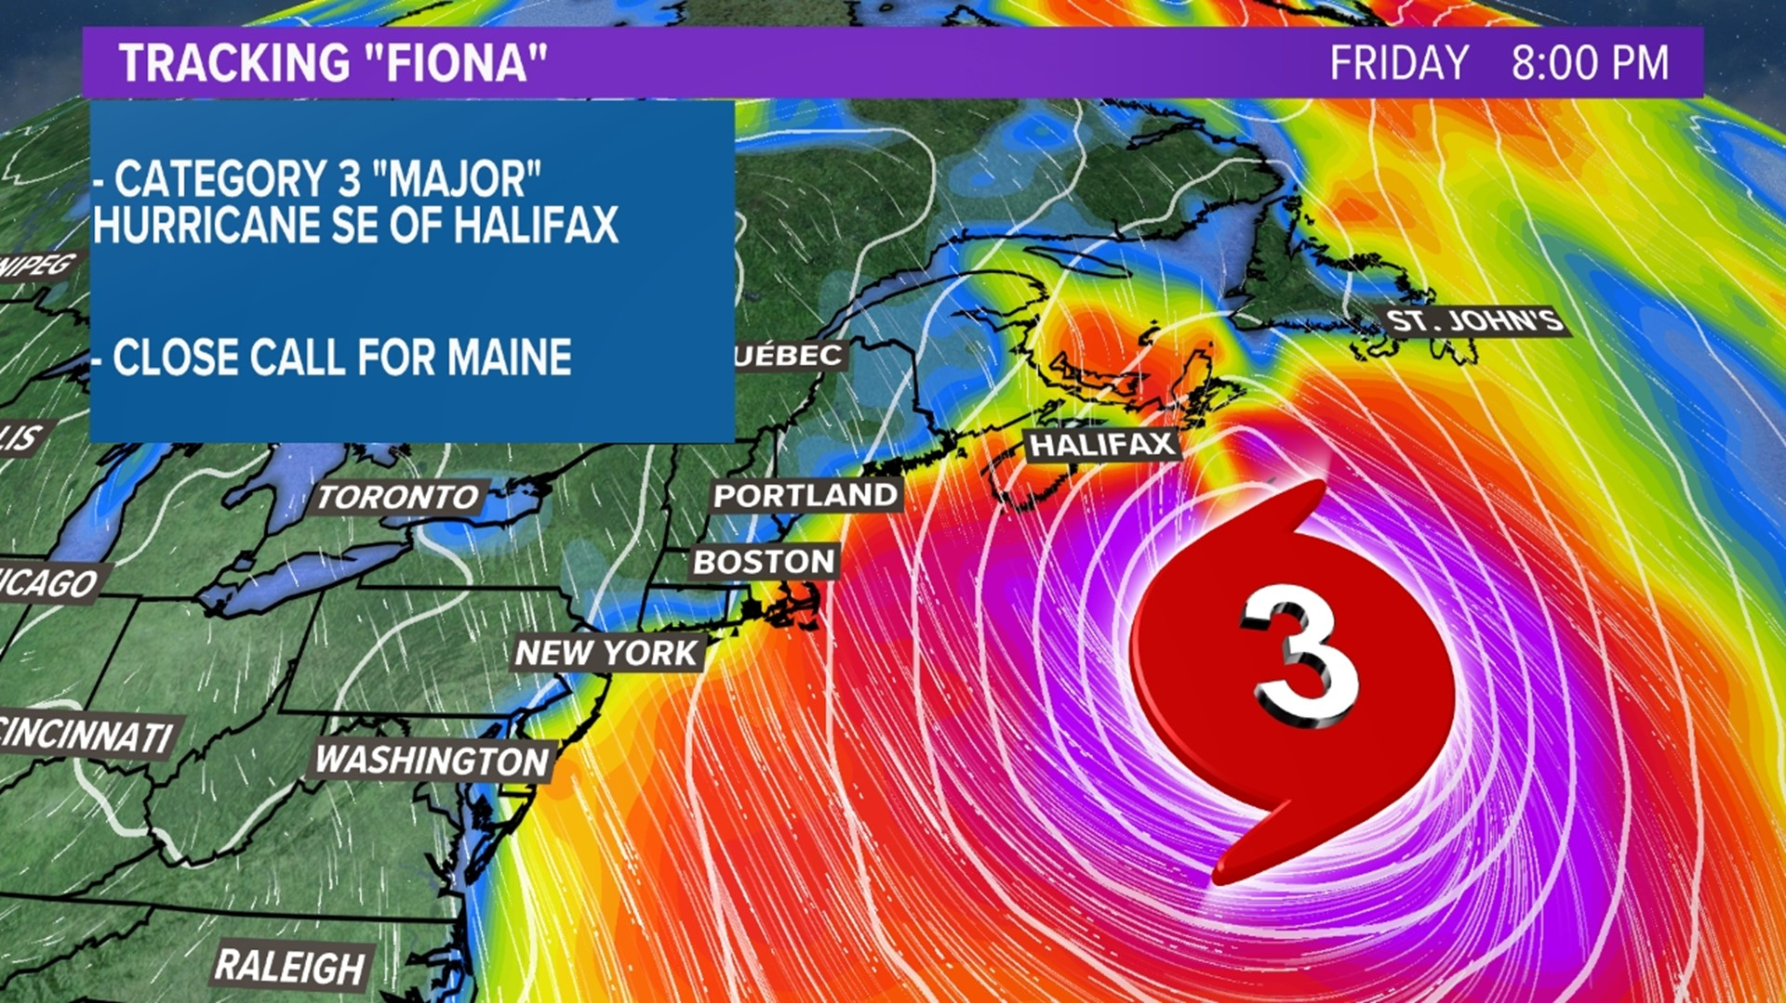
Isocontour: Isobar – Lines with Equal Pressure
https://www.newscentermaine.com/

Slide 8
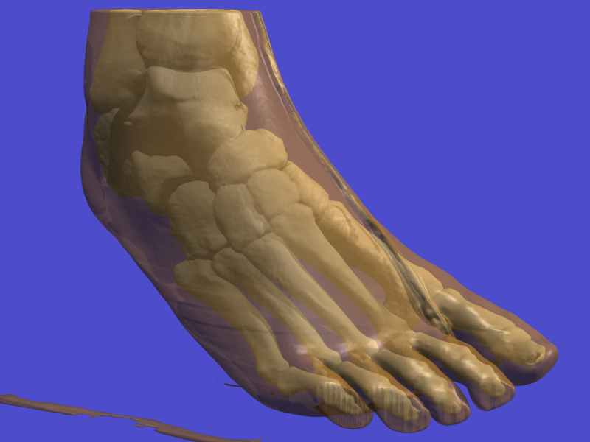
Isocontour
Application in Medical Science:
Isosurface of bone and skin
https://web.cs.ucdavis.edu/~okreylos/PhDStudies/Spring2000/ECS277/FootIso.png

Slide 9
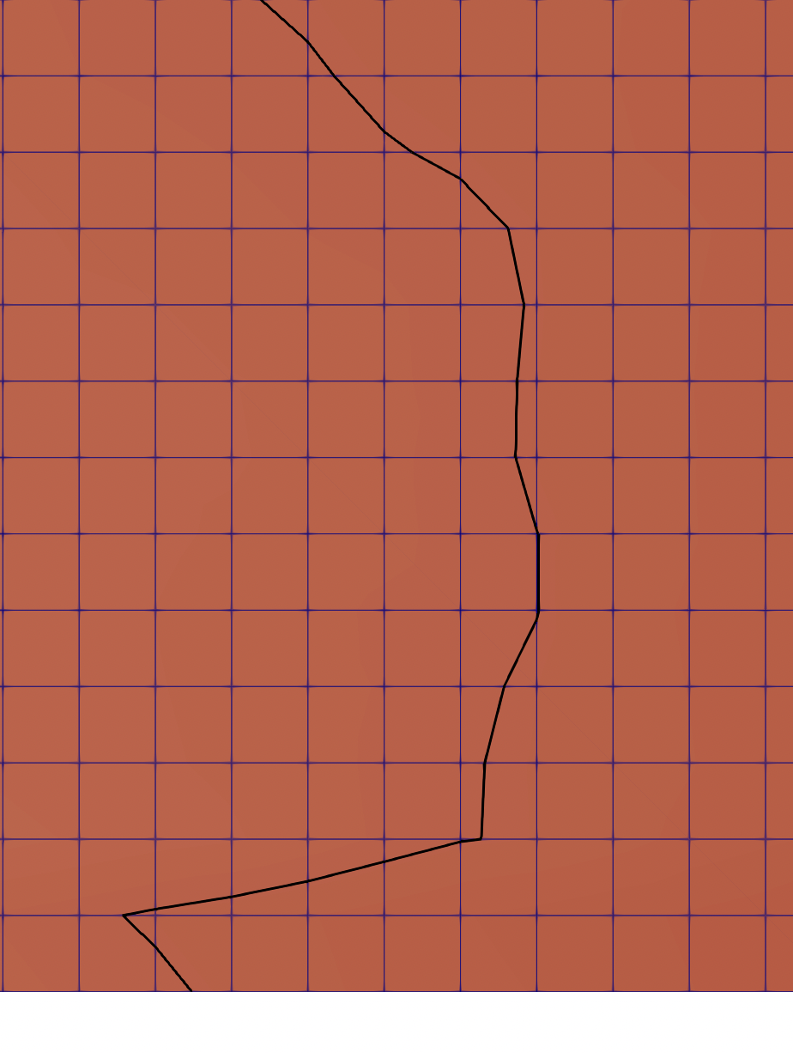
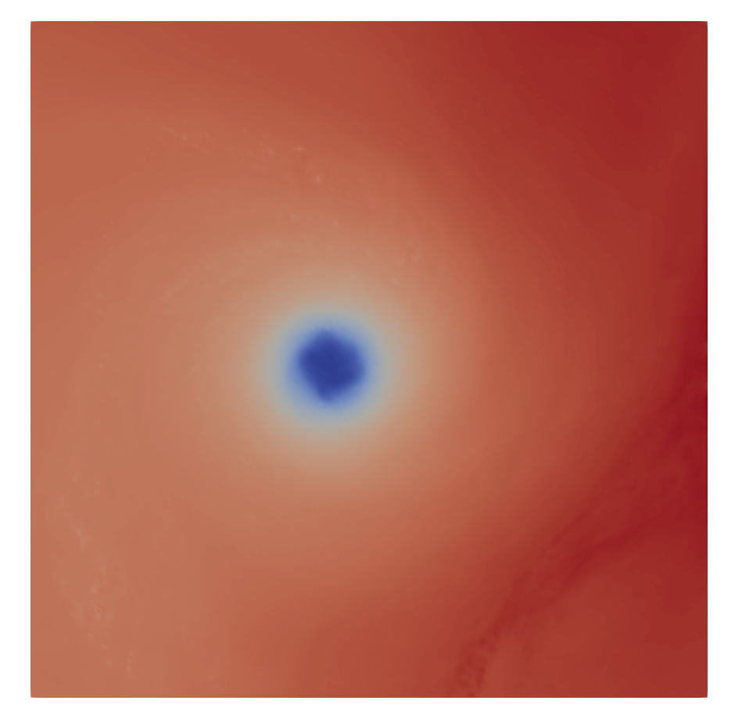
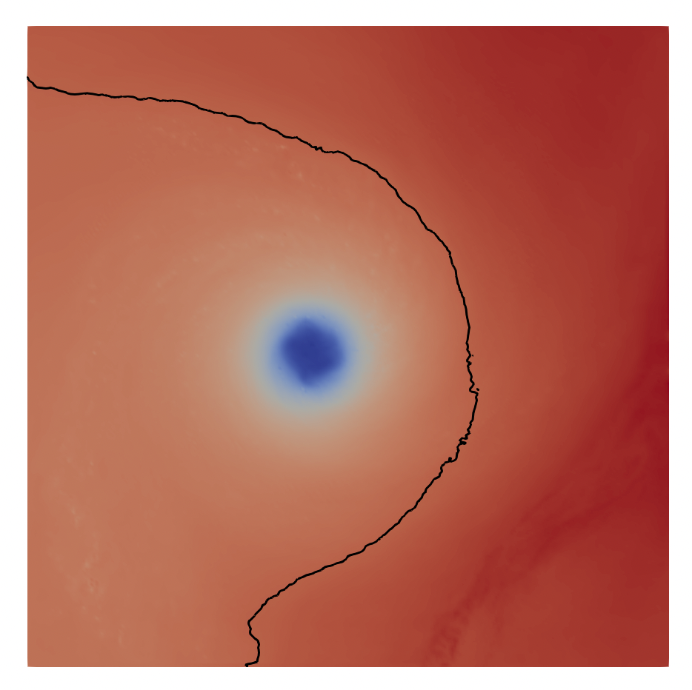
Isocontour
Isocontour (Isobar) at Pressure=250

Slide 10
Isocontour Demo with ParaView

Slide 11
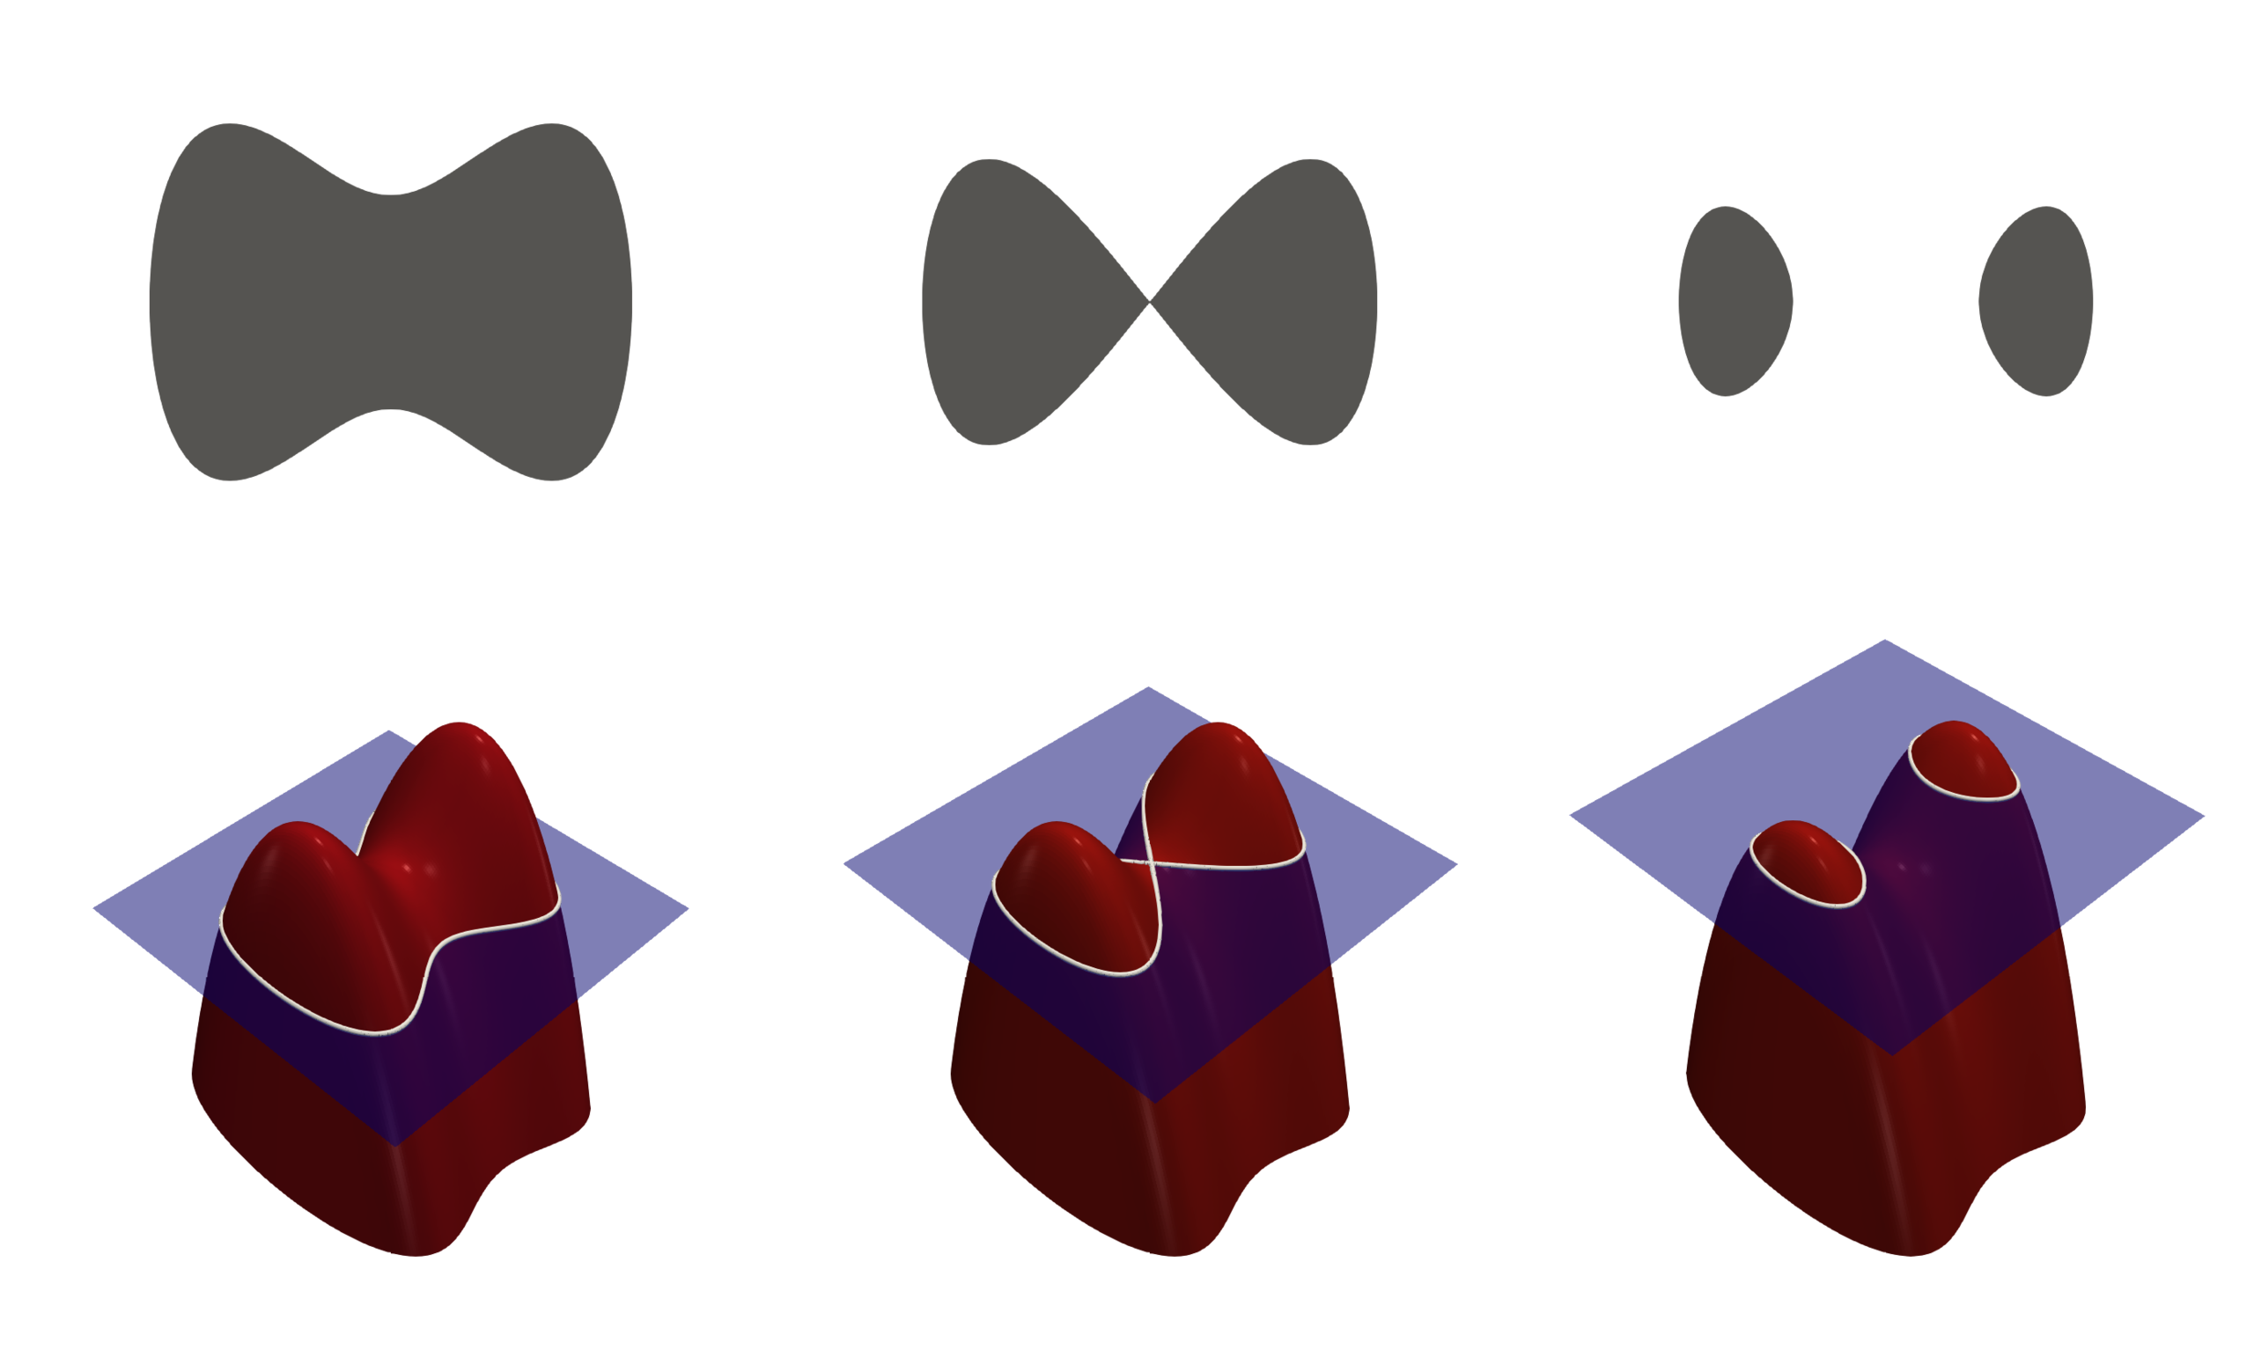
Isocontour also Known As ‘Level Set’
Suppose that F : R^{n}→R is a function and C is in the range of F. A level set corresponding to an output C is a set of all points x in the domain of F with the property that F(x)=C
In other words, all the points in the level set are assigned the same value, C, by the function F, and any point in the domain of F with output C is in that level set
https://ximera.osu.edu/mooculus/calculus3/functionsOfSeveralVariables/digInLevelSets, wikipedia

Slide 12
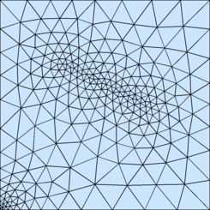
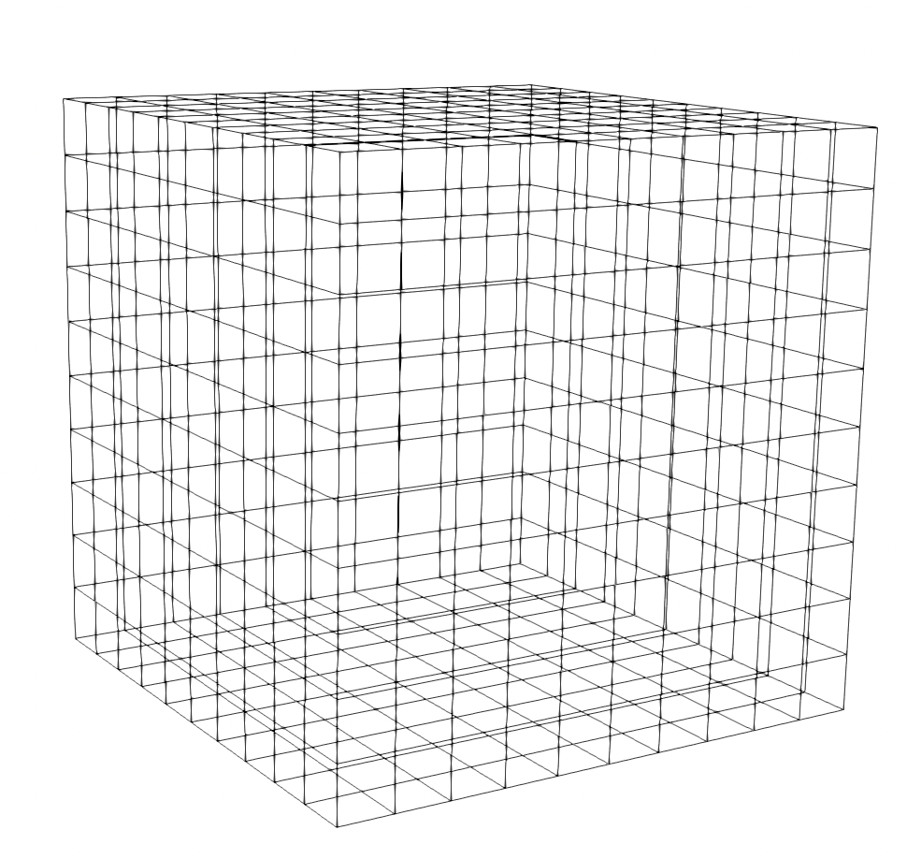
Scalar Data
Data is sampled from a continuous domain
Discrete sampled domain is represented as a grid/mesh
Triangular mesh, cube mesh etc.
The function value (scalar value) specified at mesh/grid vertices
Values can be interpolated within the mesh to get value at a query location

Slide 13
2D Isocontour Extraction
Given a 2D scalar field, compute isocontour (isoline) for isovalue = C
v3
v4
One cell
v1
v2
v1,v2,v3,v4 all are > C
No isoline in this cell

Slide 14
2D Isocontour Extraction
Given a 2D scalar field, compute isocontour (isoline) for isovalue = C
v3
v4
v3
v4
One cell
One cell
v1
v2
v1
v2
v1,v2,v3,v4 all are > C
No isoline in this cell
v1,v2,v3,v4 all are < C
No isoline in this cell

Slide 15
2D Isocontour Extraction
Given a 2D scalar field, compute isocontour (isoline) for isovalue = C
v3
v4
v3
v4
v3
v4
One cell
One cell
Active cell
v1
v2
v1
v2
v1
v2
v1,v2,v3,v4 all are > C
No isoline in this cell
v1,v2,v3,v4 all are < C
No isoline in this cell
Otherwise, cell contains isocontour
segment

Slide 16
2D Isocontour Extraction: Marching Squares
Given a 2D scalar field, compute isocontour (isoline) for isovalue = C
This is usually done in a cell-by-cell manner using Marching Squares algorithm

Slide 17

2D Isocontour Extraction: Marching Squares
Given a 2D scalar field, compute isocontour (isoline) for isovalue = C
This is usually done in a cell-by-cell manner using Marching Squares algorithm
Contour value (isovalue) = C
Value > C
Value < C

Slide 18
2D Isocontour Extraction: Marching Squares
Given a 2D scalar field, compute isocontour (isoline) for isovalue = C
This is usually done in a cell-by-cell manner using Marching Squares algorithm
Contour value (isovalue) = C
Value > C
Value < C

Slide 19
2D Isocontour Extraction: Marching Squares
Given a 2D scalar field, compute isocontour (isoline) for isovalue = C
This is usually done in a cell-by-cell manner using Marching Squares algorithm
Contour value (isovalue) = C
Value > C
Value < C

Slide 20
2D Isocontour Extraction: Marching Squares
Given a 2D scalar field, compute isocontour (isoline) for isovalue = C
This is usually done in a cell-by-cell manner using Marching Squares algorithm
Contour value (isovalue) = C
Value > C
Value < C

Slide 21
2D Isocontour Extraction: Marching Squares
Given a 2D scalar field, compute isocontour (isoline) for isovalue = C
This is usually done in a cell-by-cell manner using Marching Squares algorithm
Contour value (isovalue) = C
Value > C
Value < C

Slide 22
2D Isocontour Extraction: Marching Squares
Given a 2D scalar field, compute isocontour (isoline) for isovalue = C
This is usually done in a cell-by-cell manner using Marching Squares algorithm
Contour value (isovalue) = C
Value > C
Value < C

Slide 23
2D Isocontour Extraction: Marching Squares
Given a 2D scalar field, compute isocontour (isoline) for isovalue = C
This is usually done in a cell-by-cell manner using Marching Squares algorithm
Contour value (isovalue) = C
Value > C
Value < C

Slide 24
2D Isocontour Extraction: Marching Squares
Given a 2D scalar field, compute isocontour (isoline) for isovalue = C
This is usually done in a cell-by-cell manner using Marching Squares algorithm
Contour value (isovalue) = C
Value > C
Value < C

Slide 25
2D Isocontour Extraction: Marching Squares
Given a 2D scalar field, compute isocontour (isoline) for isovalue = C
This is usually done in a cell-by-cell manner using Marching Squares algorithm
Contour value (isovalue) = C
Value > C
Value < C

Slide 26
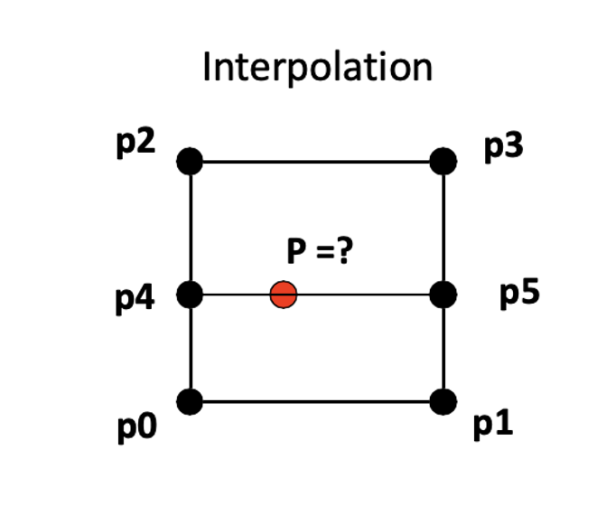
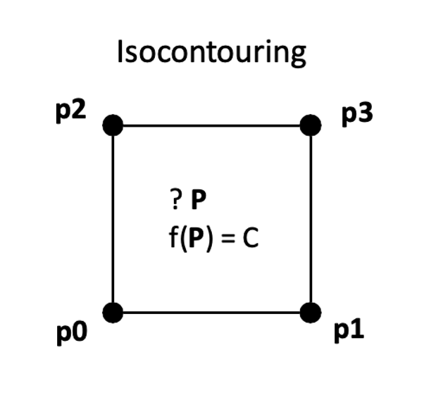
Isocontour in a 2D Cell
Finding Isocontour in a cell is an inverse problem of value interpolation

Slide 27
Isocontouring by Linear Interpolation
Compute isocontour within a cell based on linear interpolation
P3 (+)
P2 (+)
Identify edges that are ‘zero crossing’
Values at the two end points are greater (+) and smaller (-­‐) than the contour value
Calculate the positions in those edges that has value equal to isovalue
Connect the points with a line
P0 (-)
P1 (-)

Slide 28
Step 1: Identify Edges
Edges that have values greater (+) and less (-­‐) than the contour values must contain a point P that has f(p) = C
This is based on the assumption that values vary linearly and continuously across the edge
V1
V1
V2
C
V2
P1
P2

Slide 29
Step 2: Compute Intersection
The intersection point f(p) = C on the edge can be computed by linear interpolation
d1/d2 = (v1-­‐ C) / (C - v2)
(p – p1)/(p2 -­‐ p1) = (v1-­‐ C) / (v1 -­‐ v2)
p = (v1-­‐ C)/(v1 -­‐ v2) * (p2 -­‐ p1) + p1
p
V1
V1
V2
C
d1
d2
V2
P1
P2

Slide 30
Step 3: Connect the Dots
Based on the principle of linear interpolation, all points along the line P4P5 have values equal to C (isovalue)
P3 (+)
P2 (+)
P4
P5
P0 (-)
P1 (-)
Repeat Step1 – Step 3 for all cells

Slide 31

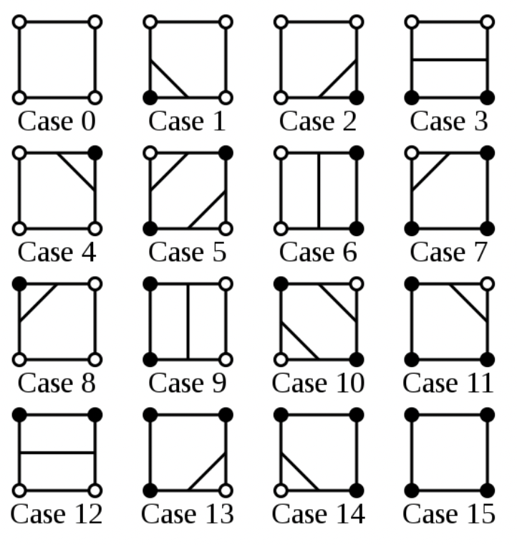

Isocontour Cases
How many ways can an isocontour intersect a rectangular cell?
1: > C
0: < C
P4 P3
P4 | P3 | P2 | P1
P1
P2
The value at each vertex can be either greater or less than the contour value
So, there are 2 x 2 x 2 x 2 = 16 cases

Slide 32
Unique Topological Cases
There are only four unique topological cases
(1) No intersection
(2) Intersect with two adjacent edges
(3) Intersect with two opposite cases
(4) Two contours pass through the cell

Slide 33
Putting it All Together
2D Isocontouring algorithm for square meshes:
Process one cell at a time
Compare the values at 4 vertices with the contour value C and identify intersected edges
Linearly interpolate along the intersected edges
Connect the interpolated points together

Slide 34
Dealing with Ambiguous Cases
Ambiguous face: A face that has two diagonally opposite points with the same sign
-
+
How to connect?
Both configurations are possible!
-
+
+
-
-
+
+
-
+
-

Slide 35
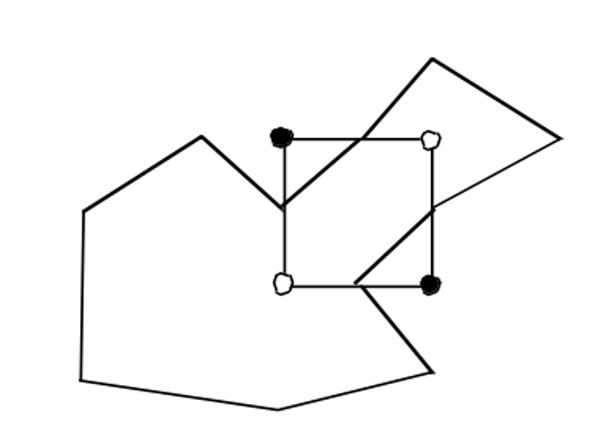
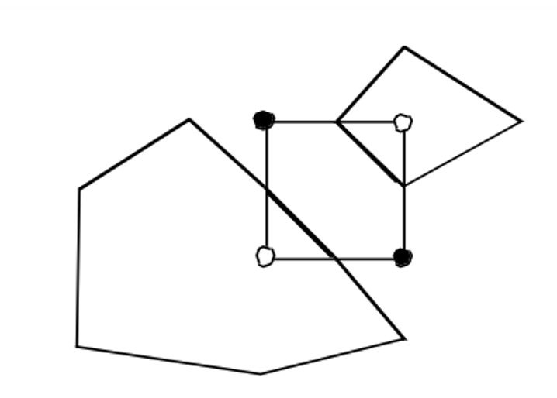
Dealing with Ambiguous Cases
Ambiguous face: A face that has two diagonally opposite points with the same sign
Broken Contour
Connected Contour

Slide 36
Dealing with Ambiguous Cases
Ambiguous face: A face that has two diagonally opposite points with the same sign
-
+
How to connect?
Both configurations are possible!
One way to resolve: Use Asymptotic decider
-
+
+
-
-
+
The Asymptotic Decider: Resolving the Ambiguity in Marching Cubes by Nielson and Hamman, IEEE VIS’91
+
-
+
-

Slide 37
3D Isocontour: Isosurface
The 2D algorithm extends naturally to 3D where the data will have 3D cells
Identify ‘active cells’: cells that intersect with the Isosurface
Linear interpolation along edges in active cells
Compute surface patches within each cell based on the edges that have intersected with the Isosurface
Cube/Rectangular cell
Tetrahedron cell

Slide 38
Tetrahedral Cell
Active cells: min value < C < max value
Mark cell vertices that are greater than C with “+” and smaller than C with “-”
Each cell has 4 vertices
Each vertex can have value greater or less than C
Hence, 2x2x2x2 = 16 possible combinations
Only three unique topological cases
Tetrahedron cell

Slide 39
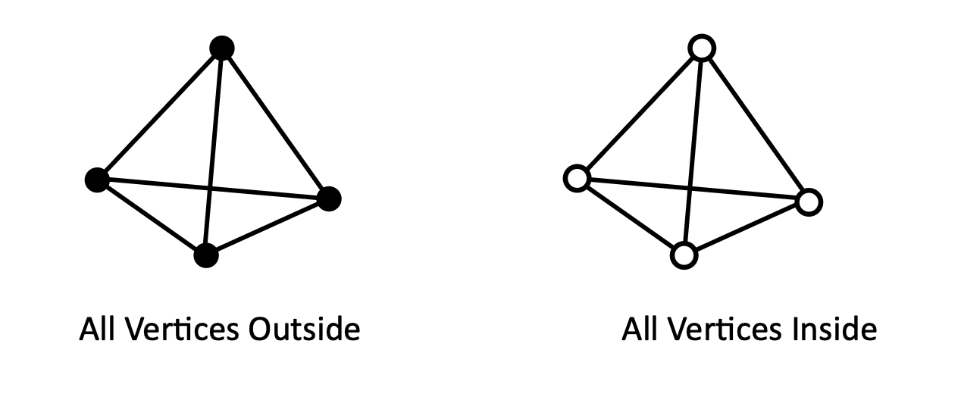
Tetrahedral Cell: Case 1
Case 1: No intersection (all vertices are either outside or inside)
Values at all cell vertices are either larger or smaller than the isovalue C
If we assume that cell values greater than the contour value C as ‘outside’ and smaller as ‘inside’, then all cell vertices are either completely inside or outside of the isosurface

Slide 40
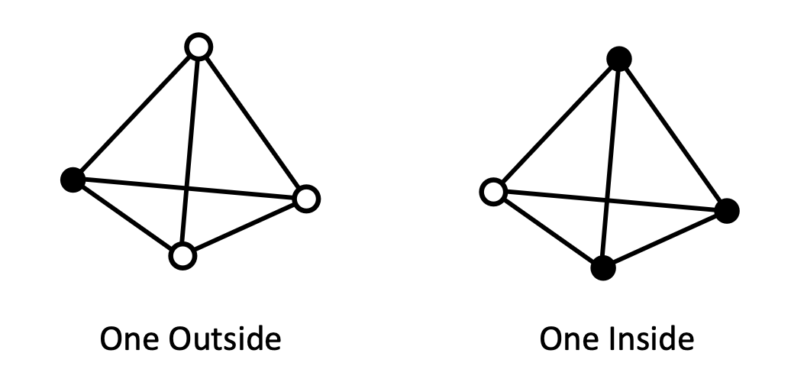
Tetrahedral Cell: Case 2
Case 2: One vertex outside (or inside)
Isosurface only intersects with edges that have ‘+’ and ‘–’ vertices at two ends

Slide 41
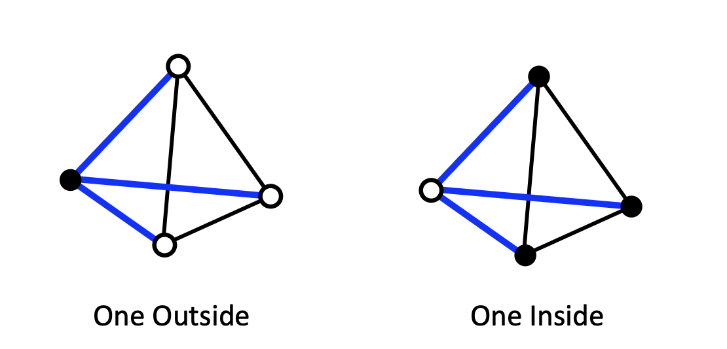
Tetrahedral Cell: Case 2
Case 2: One vertex outside (or inside)
Isosurface only intersects with edges that have ‘+’ and ‘–’ vertices at two ends

Slide 42
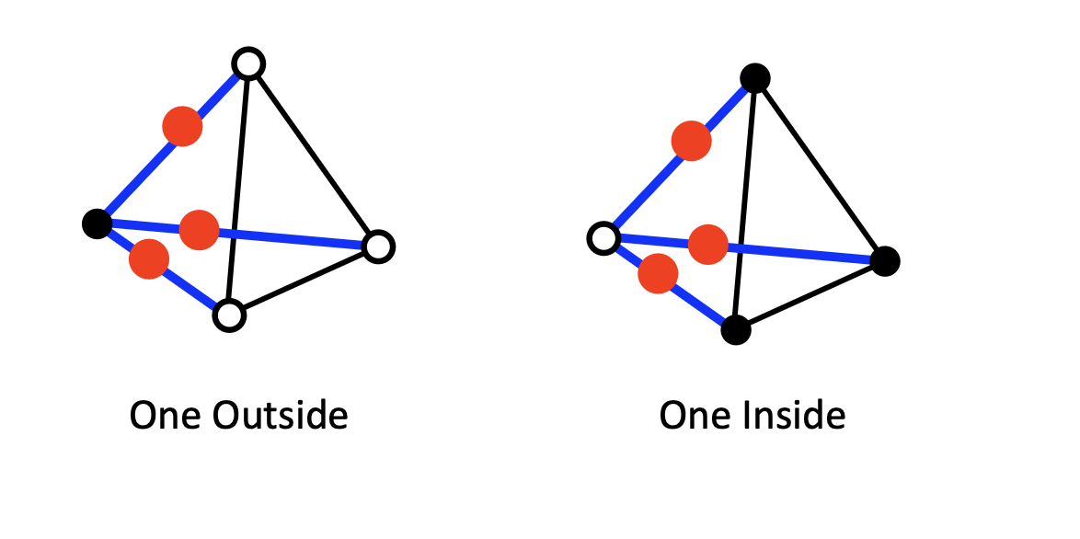
Tetrahedral Cell: Case 2
Case 2: One vertex outside (or inside)
Compute intersection points on active edges

Slide 43
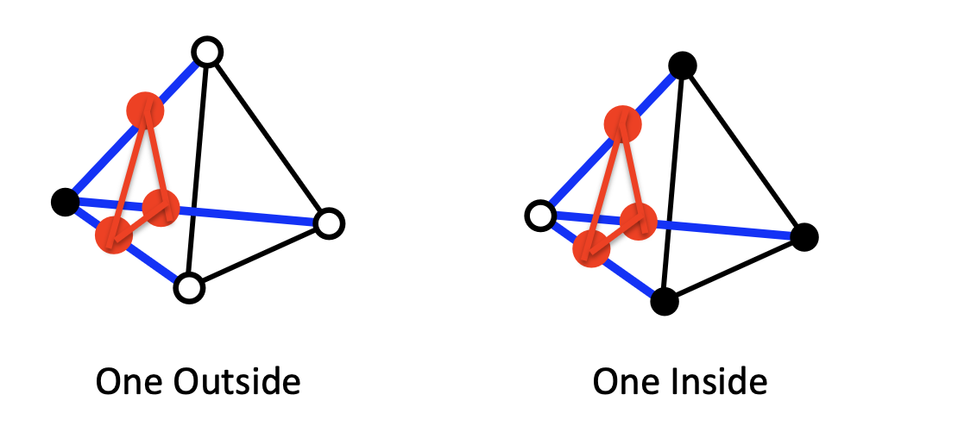
Tetrahedral Cell: Case 2
Case 2: One vertex outside (or inside)
Connect intersection points into a triangle

Slide 44
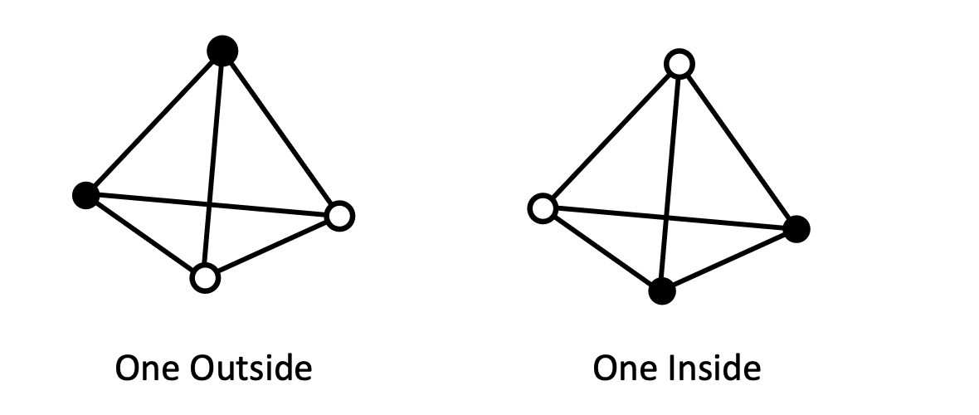
Tetrahedral Cell: Case 3
Case 3: Two vertices outside (or inside)
Isosurface only intersects with edges that have ‘+’ and ‘–’ vertices at two ends

Slide 45
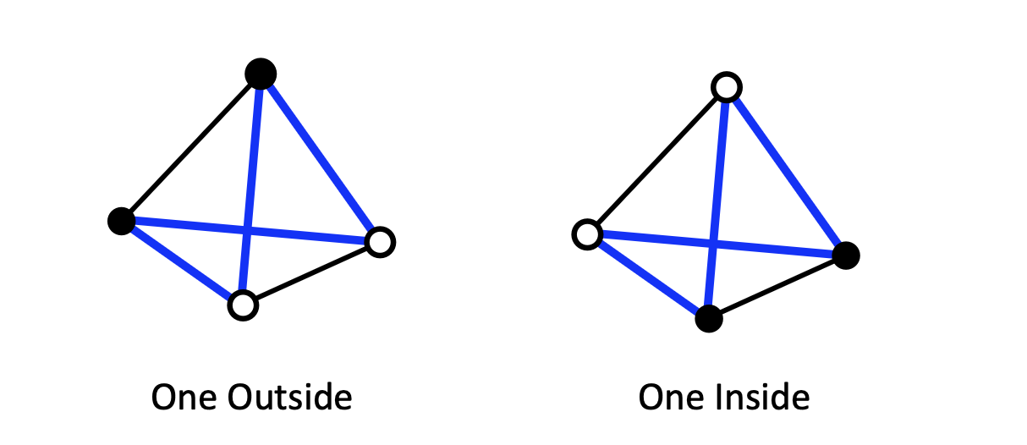
Tetrahedral Cell: Case 3
Case 3: Two vertices outside (or inside)
Isosurface only intersects with edges that have ‘+’ and ‘–’ vertices at two ends

Slide 46
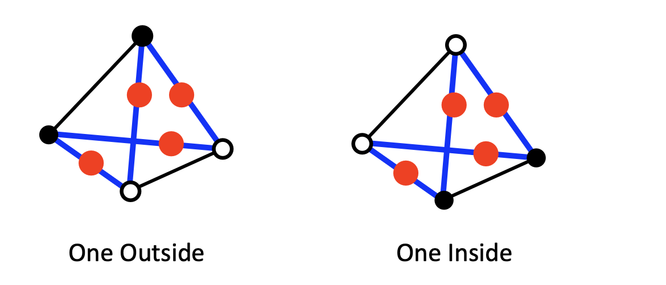
Tetrahedral Cell: Case 3
Case 3: Two vertices outside (or inside)
Compute intersection points on active edges

Slide 47
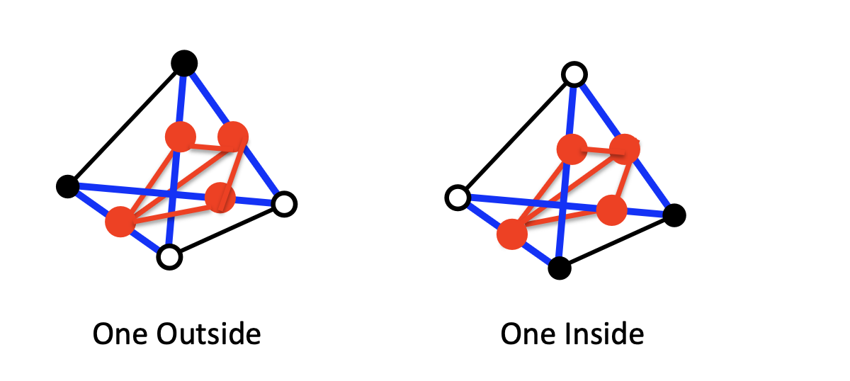
Tetrahedral Cell: Case 3
Case 3: Two vertices outside (or inside)
Connect intersection points into a triangle

Slide 48
3D Isocontour: Cube/Rectangular Cells
With 8 vertices in a cell, each having a value greater or smaller than the contour value, there can be 2⁸ ⁼ 256 possible cases
Cube/Rectangular cell

Slide 49


3D Isocontour: Cube/Rectangular Cells
With 8 vertices in a cell, each having a value greater or smaller than the contour value, there can be 2⁸ ⁼ 256 possible cases
Cube/Rectangular cell
But the total number of unique topological cases is much less than 256

Slide 50
Case Reduction
The topology of the surface does not change, and the unique number of cases reduces to 15 from 256
Value Symmetry
Rotational Symmetry
_
_
+
+
_
+
_
+
_
+
_
+
_
_
+
Value Symmetry
+

Slide 51
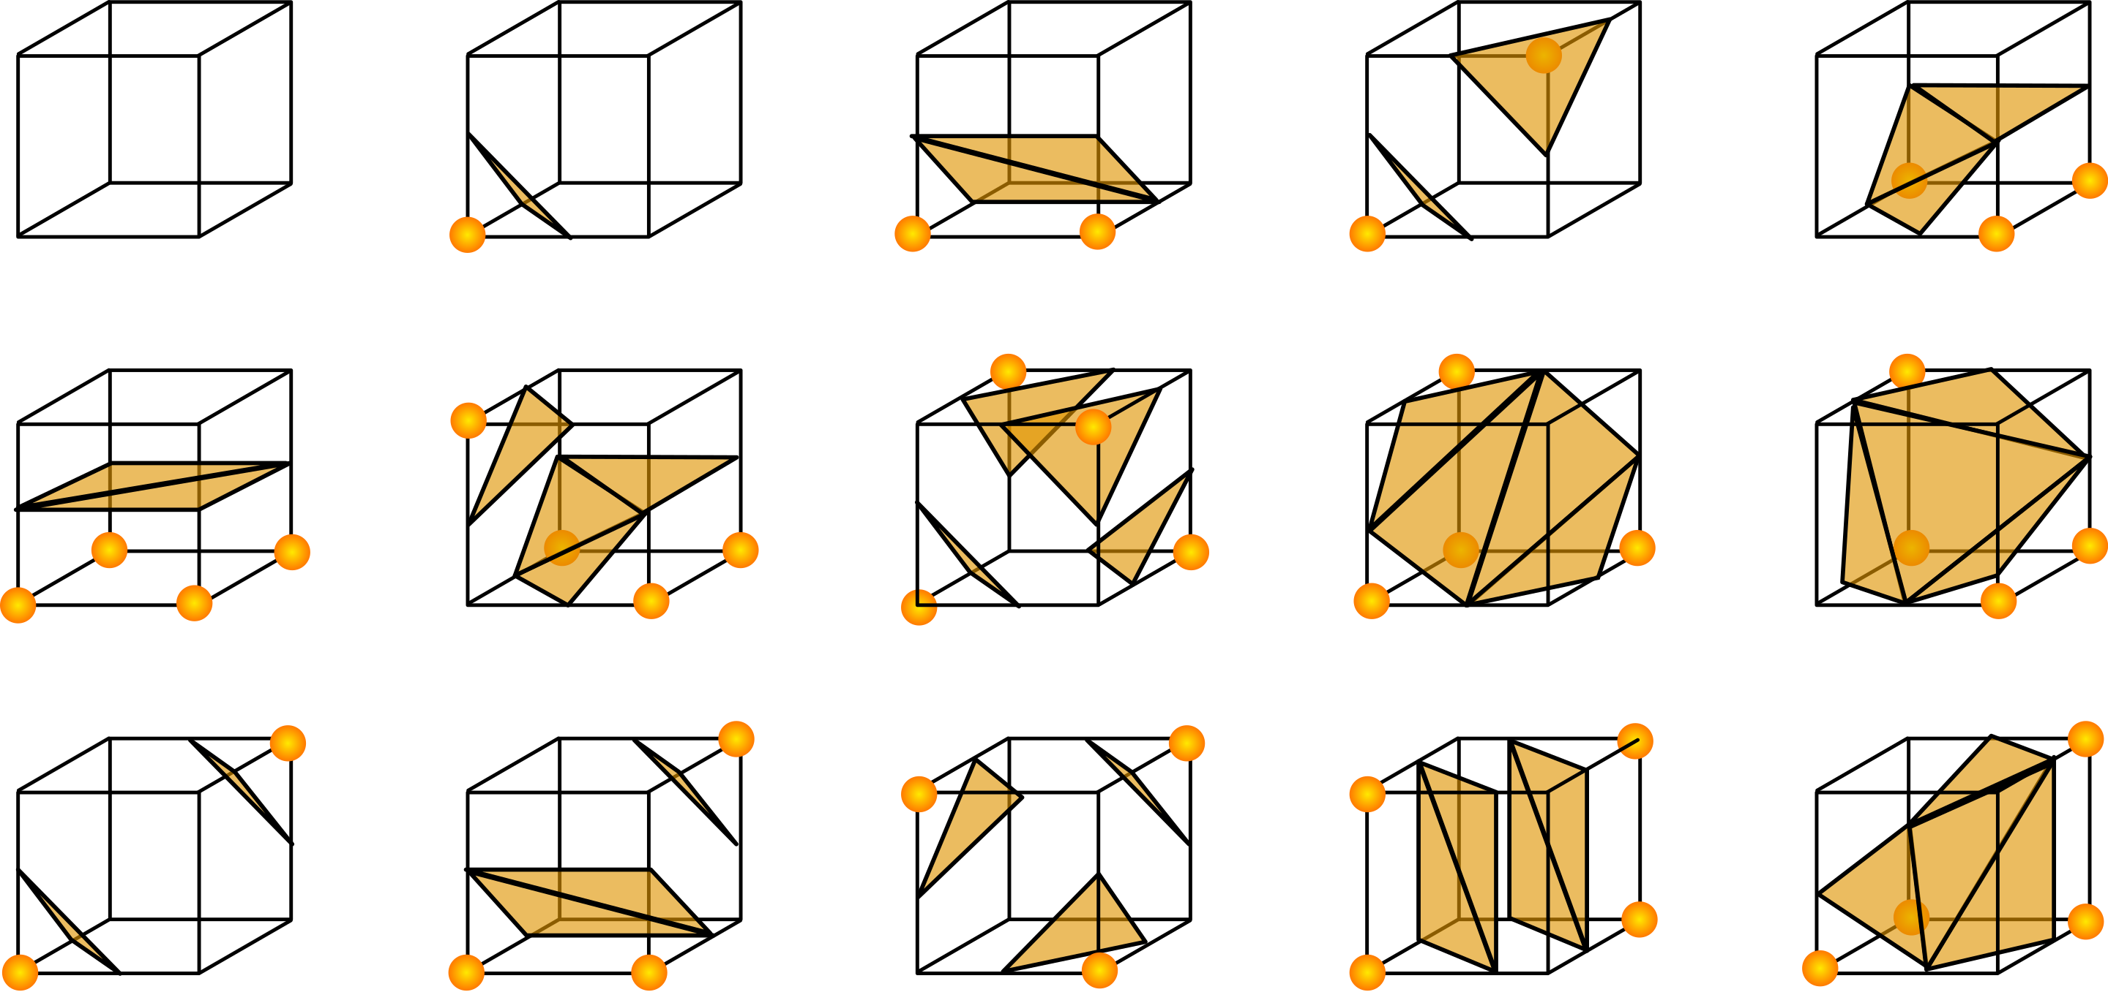
3D Isosurface Unique Cases
15 Topologically Unique Cases
Wikipedia

Slide 52
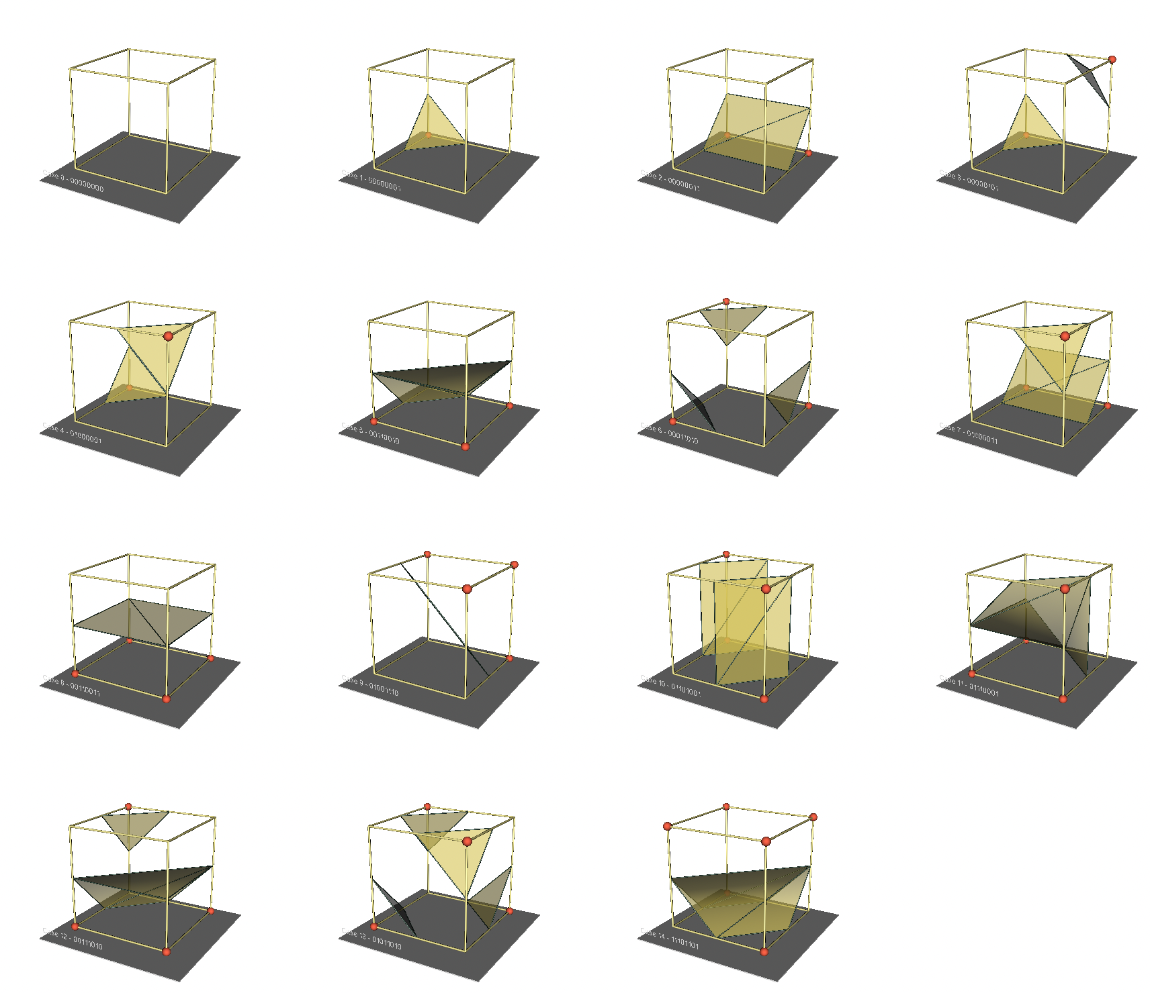
VTK Demo: Marching Cubes Cases
Source: https://gitlab.kitware.com/vtk/vtk-examples/-/tree/master/src/Python/VisualizationAlgorithms/MarchingCases.py

Slide 53
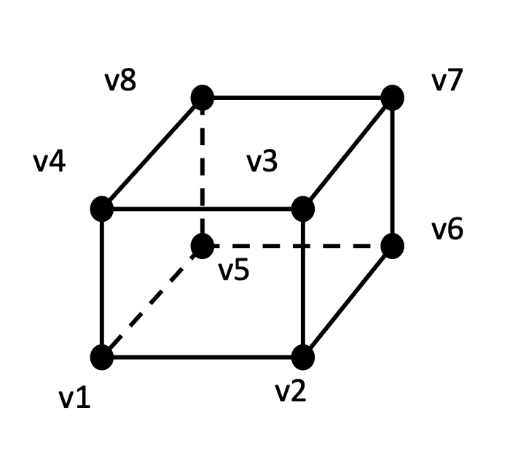
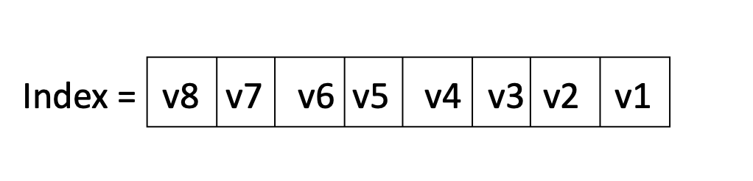
Marching Cubes Algorithm
Lorensen and Cline in 1987
Mark each cell with a bit
V_{i} is 1 if value > C (C=isovalue)
V_{i} is 0 if value < C
Each cell has an index mapped to a value ranged [0,255]

Slide 54
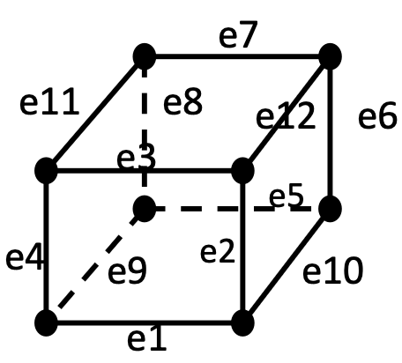
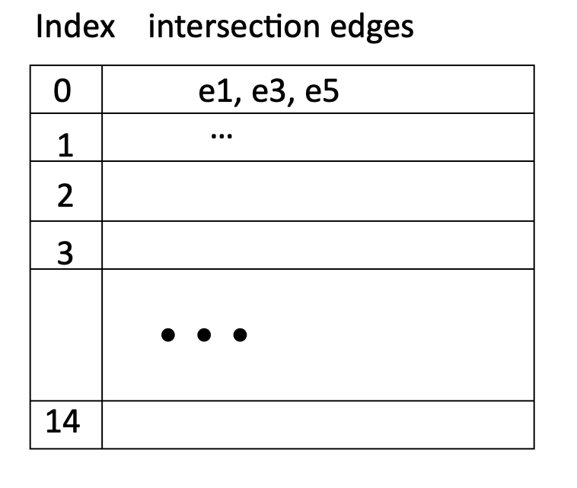
Marching Cubes Algorithm
Based on the values at the vertices, map the cell to one of the 15 cases
Perform a table lookup to see what edges have intersections

Slide 55
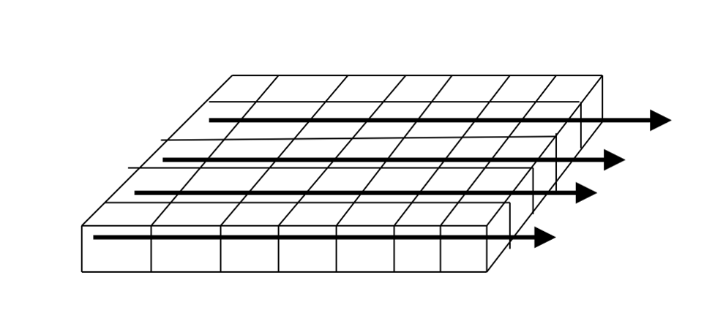
Marching Cubes Algorithm
Perform linear interpolation to compute the intersection points at the edges
Connect the points to form surface patches
Sequentially scan through the cells – row by row, layer by layer

Slide 56
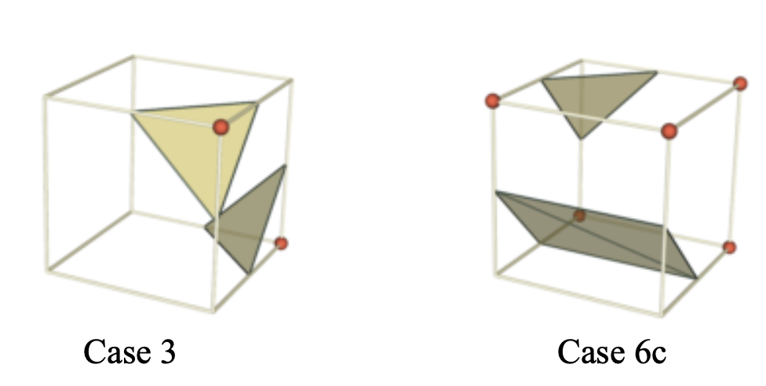
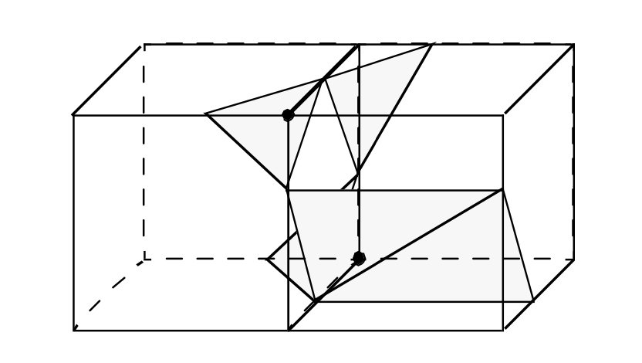
Ambiguity in Marching Cubes
Arbitrarily choosing marching cubes cases leads to holes in the isosurface

Slide 57
Dealing With Ambiguity
Use ‘Asymptotic decider’
Idea is similar and extends to 3D
More details can be found is the paper: “Resolving the Ambiguity in Marching Cubes” by Nielson and Hamman, IEEE VIS’91

Slide 58
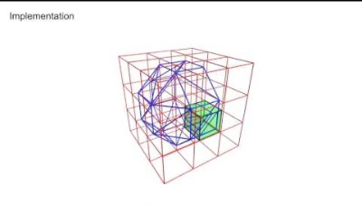
Marching Cubes Algorithm: Animation
https://www.youtube.com/watch?v=B_xk71YopsA

